Slide 1
Naïve Bayes Classifier Algorithm

Slide 2
Introduction
Naïve Bayes algorithm is a supervised learning algorithm, which is based on Bayes theorem and used for solving classification problems.
It is mainly used in text classification that includes a high-dimensional training dataset.
Naïve Bayes Classifier is one of the simple and most effective Classification algorithms which helps in building the fast machine learning models that can make quick predictions.

Slide 3
Introduction
It is a probabilistic classifier, which means it predicts on the basis of the probability of an object.
Some popular examples of Naïve Bayes Algorithm are spam filtration, Sentimental analysis, and classifying articles
It is called Naïve because it assumes that the occurrence of a certain feature is independent of the occurrence of other features.
Such as if the fruit is identified on the bases of color, shape, and taste, then red, spherical, and sweet fruit is recognized as an apple.
Hence each feature individually contributes to identify that it is an apple without depending on each other.
Bayes: It is called Bayes because it depends on the principle of Bayes' Theorem

Slide 4

Bayes' Theorem:
Bayes' theorem is also known as Bayes' Rule or Bayes' law, which is used to determine the probability of a hypothesis with prior knowledge.
It depends on the conditional probability.
The formula for Bayes' theorem is given as:
P(A|B) is Posterior probability: Probability of hypothesis A on the observed event B.
P(B|A) is Likelihood probability: Probability of the evidence given that the probability of a hypothesis is true.
P(A) is Prior Probability: Probability of hypothesis before observing the evidence.
P(B) is Marginal Probability: Probability of Evidence.

Slide 5
Example
Suppose we have a dataset of weather conditions and corresponding target variable "Play".
So using this dataset we need to decide that whether we should play or not on a particular day according to the weather conditions.
So to solve this problem, we need to follow the below step
1. Convert the given dataset into frequency tables.
2. Generate Likelihood table by finding the probabilities of given features.
3. Now, use Bayes theorem to calculate the posterior probability.

Slide 6

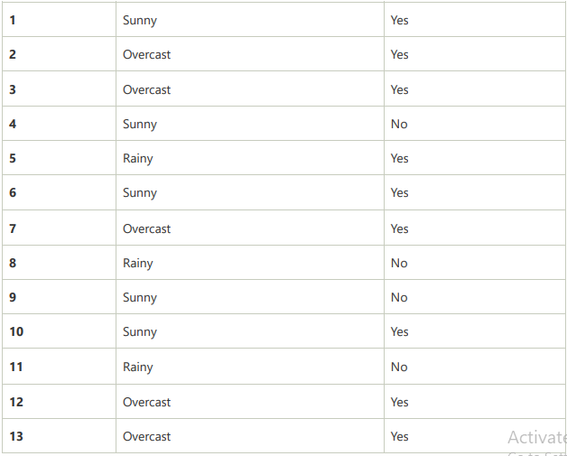
Problem: If the weather is sunny, then the Player should play or not?

Slide 7
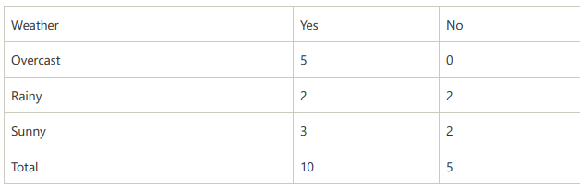
Frequency table for the Weather Conditions:

Slide 8
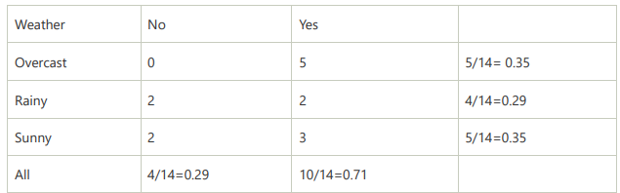
Likelihood table weather condition:

Slide 9
Applying Bayes'theorem:
P(Yes|Sunny)= P(Sunny|Yes)*P(Yes)/P(Sunny)
P(Sunny|Yes)= 3/10= 0.3
P(Sunny)= 0.35
P(Yes)=0.71
So P(Yes|Sunny) = 0.3*0.71/0.35= 0.60
P(No|Sunny)= P(Sunny|No)*P(No)/P(Sunny)
P(No)= 0.29
P(Sunny)= 0.35 So
P(No|Sunny)= 0.5*0.29/0.35 = 0.41
So as we can see from the above calculation that P(Yes|Sunny)>P(No|Sunny) Hence on a Sunny day, Player can play the game

Slide 10
Advantages of Naïve Bayes Classifier:
Naïve Bayes is one of the fast and easy ML algorithms to predict a class of datasets.
It can be used for Binary as well as Multi-class Classifications.
It performs well in Multi-class predictions as compared to the other Algorithms.
It is the most popular choice for text classification problems.
Disadvantages of Naïve Bayes Classifier:
Naive Bayes assumes that all features are independent or unrelated, so it cannot learn the relationship between features

Slide 11
Applications of Naïve Bayes Classifier:
It is used for Credit Scoring.
It is used in medical data classification.
It can be used in real-time predictions because Naïve Bayes Classifier is an eager learner.
It is used in Text classification such as Spam filtering and Sentiment analysis.

Slide 12
Logistic Regression

Slide 13
Introduction
Binary logistic regression models the relationship between a set of independent variables and a binary dependent variable.
It is useful when the dependent variable is dichotomous in nature, like death or survival, absence or presence and so on.
Independent variables can be categorical or continuous, for example, gender, age, income or geographical region.
Binary logistic regression models a dependent variable as a logit of p, where p is the probability that the dependent variables take a value of 1.

Slide 14
Example
Binary logistic regression models are used across many domains and sectors.
For example, it can be used in marketing analytics to identify potential buyers of a product
in human resources management to identify employees who are likely to leave a company
in risk management to predict loan defaulters, or in insurance.
All of these objectives are based on information such as age, gender, occupation, premium amount, purchase frequency, and so on.
In all these objectives, the dependent variable is binary, whereas independent variables are categorical or continuous.

Slide 15
Why can’t we use linear regression for binary dependent variables?
One reason is that the distribution of Y is random and not normal as in the case of linear regression.
Linear regression is suitable for predicting a continuous value such as the price of property based on area in square feet.
In such a case the regression line is a straight line.
Logistic regression on the other hand is used for classification problems, which predict a probability that a dependent variable Y takes a value of 1, given the values of predictors.
In binary logistic regression, the regression curve is a sigmoid curve.

Slide 16
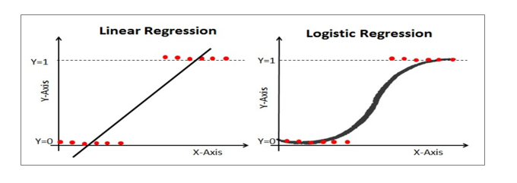

Slide 17
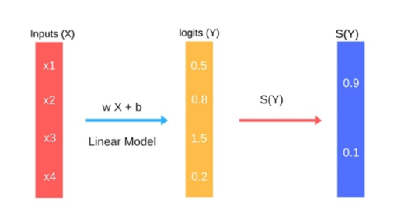

Slide 18

The Logistic Regression is NOT A CLASSIFIER
Yes, it is not.
It is rather a regression model in the core of its heart.
it is easy to say that the linear regression predicts a “value” of the targeted variable through a linear combination of the given features
while on the other hand, a Logistic regression predicts “probability value” through a linear combination of the given features plugged inside a logistic function (aka inverse-logit) given as :

Slide 19
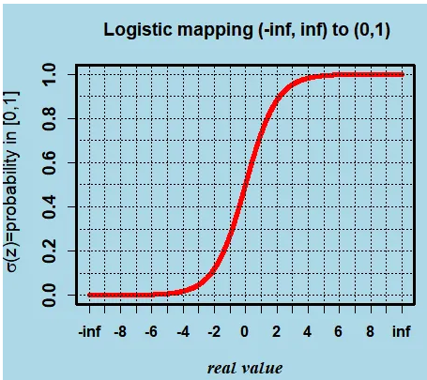

Slide 20
The Logistic Regression is NOT A CLASSIFIER
Hence the name logistic regression. This logistic function is a simple strategy to map the linear combination “z”, lying in the (-inf,inf) range to the probability interval of [0,1]
in the context of logistic regression, this z will be called the log(odd) or logit or log(p/1-p))
Consequently, Logistic regression is a type of regression where the range of mapping is confined to [0,1]
unlike simple linear regression models where the domain and range could take any real value.

Slide 21
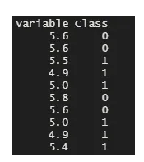
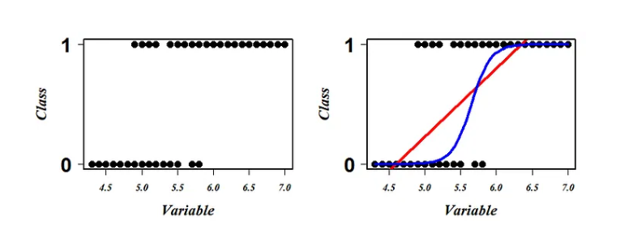
The Logistic Regression is NOT A CLASSIFIER

Slide 22

The Logistic Regression is NOT A CLASSIFIER
Logistic regression is a scheme to search this most optimum blue squiggly line.
Now first let's understand what each point on this squiggly line represents. given any variable value projected on this line, this squiggly line tells the probability of falling in Class 1 (say “p”) for that projected variable value.
So accordingly the line tells that all the bottom points that lie on this blue line have zero chances (p=0) of being in class 1 and the top points that lie on it have the probability of 1(p=1) for the same.
Now, remember that logistic (aka inverse-logit) is a strategy to map infinitely stretching space (-inf, inf) to a probability space of [0,1], a logit function could transform the probability space of [0,1] to a space stretching to (-inf, inf) eq().

Slide 23

Binomial distributions and odds
A survey of 250 customers of an automobile dealership. The customers were asked if they would recommend the service department to a friend.
The number who responded Yes was 210.
In the notation , p is the proportion of customers in the population of customers from which the sample was drawn who would respond Yes to the question.
The number of customers who would respond Yes in an simple random sample of size n has the binomial distribution with parameters n and p.
The sample size of customers is n = 250, and the number who responded Yes is the count X = 210. The sample proportion is

Slide 24

Odds of responding Yes.
Logistic regressions work with odds rather than proportions. The odds are simply the ratio of the proportions for the two possible outcomes.
If p is the proportion for one outcome, then 1 - p is the proportion for the second outcome:
For the customer service data, the proportion of customers who would recommend the service in the sample of customers is p = 0.84, so the proportion of customers who would not recommend the service department
1- p = 1 - 0.84 = 0.16
Therefore, the odds of recommending the service department are

Slide 25
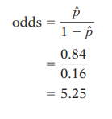
Odds of responding Yes.
When people speak about odds, they often round to integers or fractions. If we round 5.25 to 5/1, we would say that the odds are approximately 5 to 1 that a customer would recommend the service to a friend. In a similar way, we could describe the odds that a customer would not recommend the service as 1 to 5.

Slide 26
Model for logistic regression
In simple linear regression, we modeled the mean µ_{y} of the response variable y as a linear function of the explanatory variable: µ = B0 + B1x.
When y is just 1 or 0 (success or failure), the mean is the probability p of a success.
Logistic regression models the mean p in terms of an explanatory variable x.
We might try to relate p and x as in simple linear regression: p = B0 +b1x.
Unfortunately, this is not a good model. Whenever b1 Þ 0, extreme values of x will give values of b0 1 b1x that fall outside the range of possible values of p,0 # p # 1.

